Slide 1
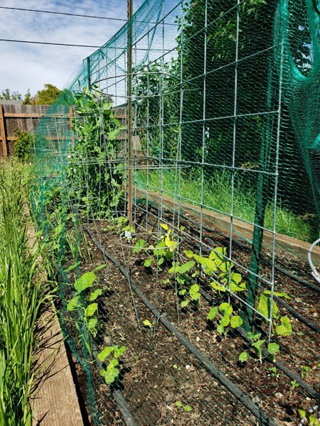
Garden App Demo 2
Group Kira: Daniel Dietrich, Gavin Cyr, Kira Luethe, Richard Williams, Todd Wood

Slide 2


Agenda
Kira- Intro & User Interface
Todd- Plant Search
Gavin – ZIP Code Search
Dan – User Authentication
Richard “Matt” - API

Slide 3

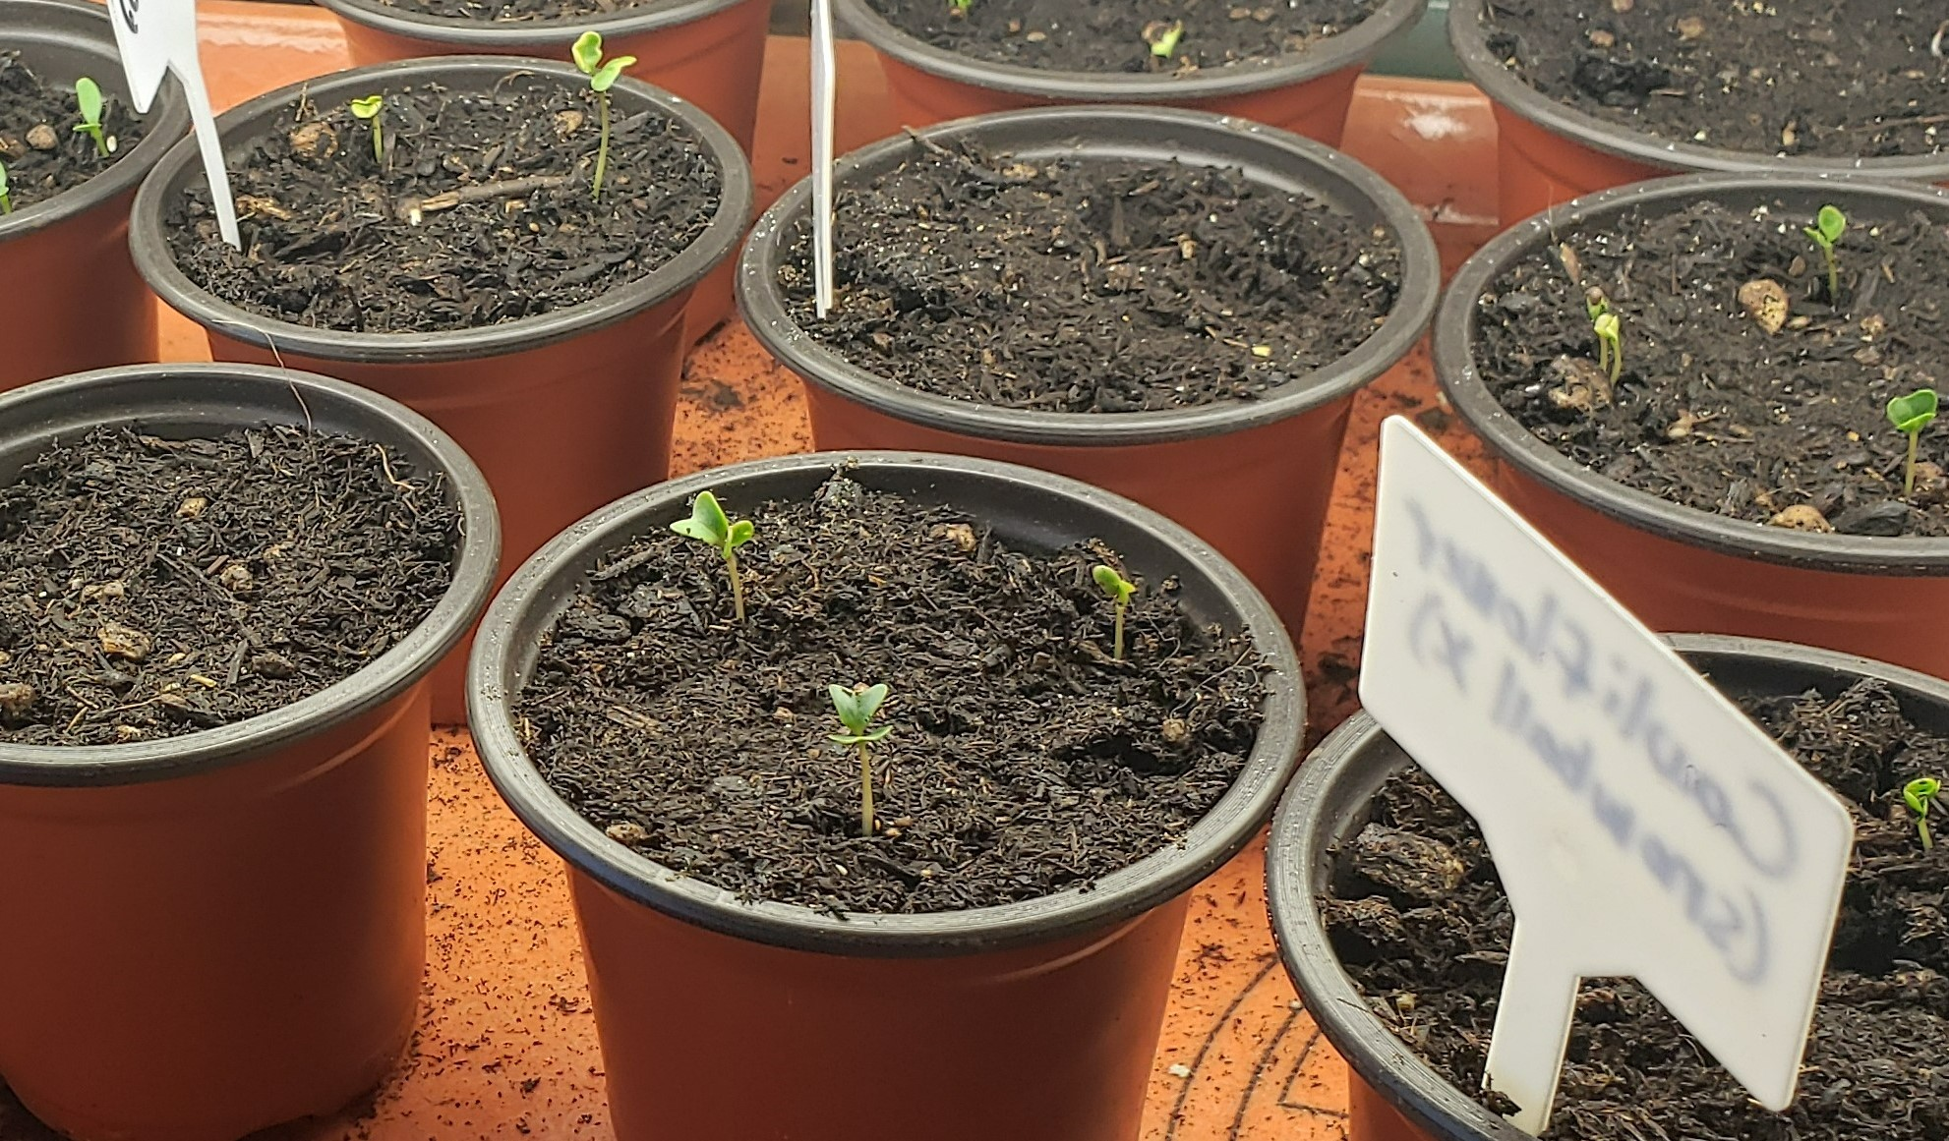
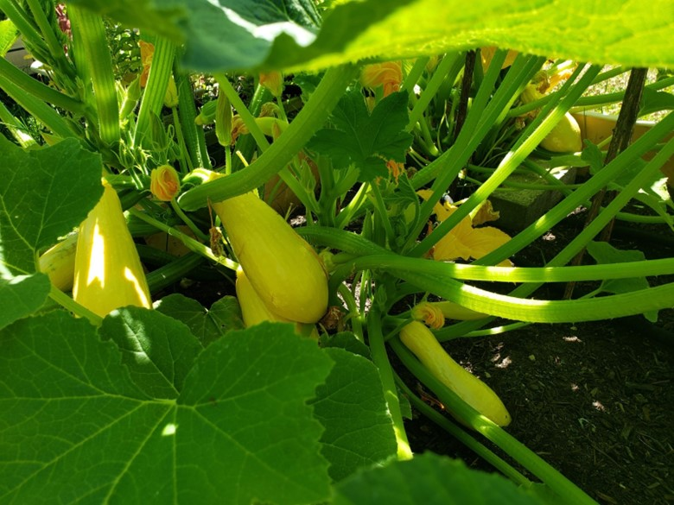
Intro & User Interface
Kira Luethe

Slide 4
Intro & User Interface
What is Garden App?
New Features
An app designed to help hobby gardeners
Look up plant information
Find information based on USDA Planting Hardiness Zones
Keep track of when users planted their seeds
Mobile Friendly user interface
Sign in/Sign up/Sign In/Account Information links are now visible when appropriate, depending on user’s logged in status.

Slide 5
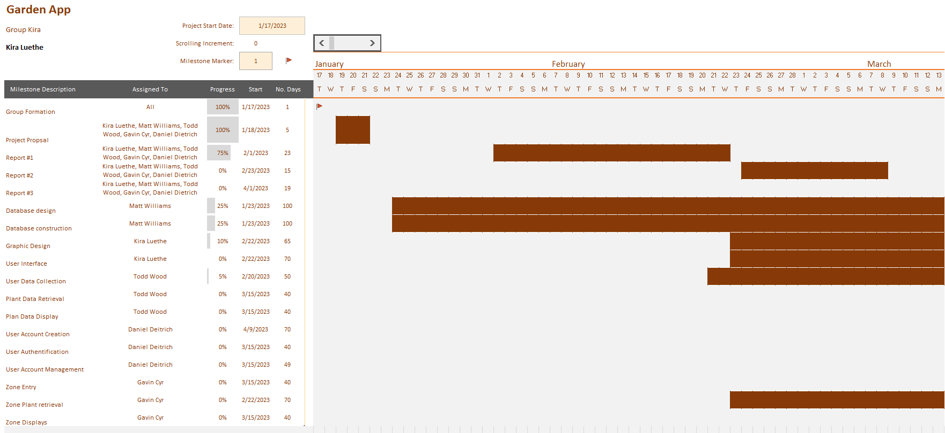
Plan of Work

Slide 6
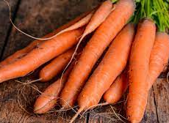
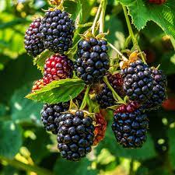
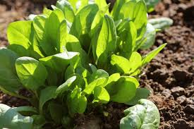
Plant Search
Todd M. Wood

Slide 7
Plant Search Functionality
Purpose & Features:
How the new functionality works:
Allows the user to get a list of plants
General Search – no criteria
Search by plant name
Search by plant type
Added Features
Retrieve Stored plants
Add or remove plants
Set dates planted
The user enters logs in
System retrieves user's plants
User can add new plants
User can remove plants
User can set their planting dates
System will save the last state of the user's plants

Slide 8

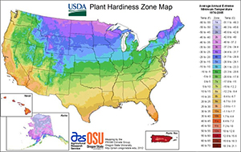
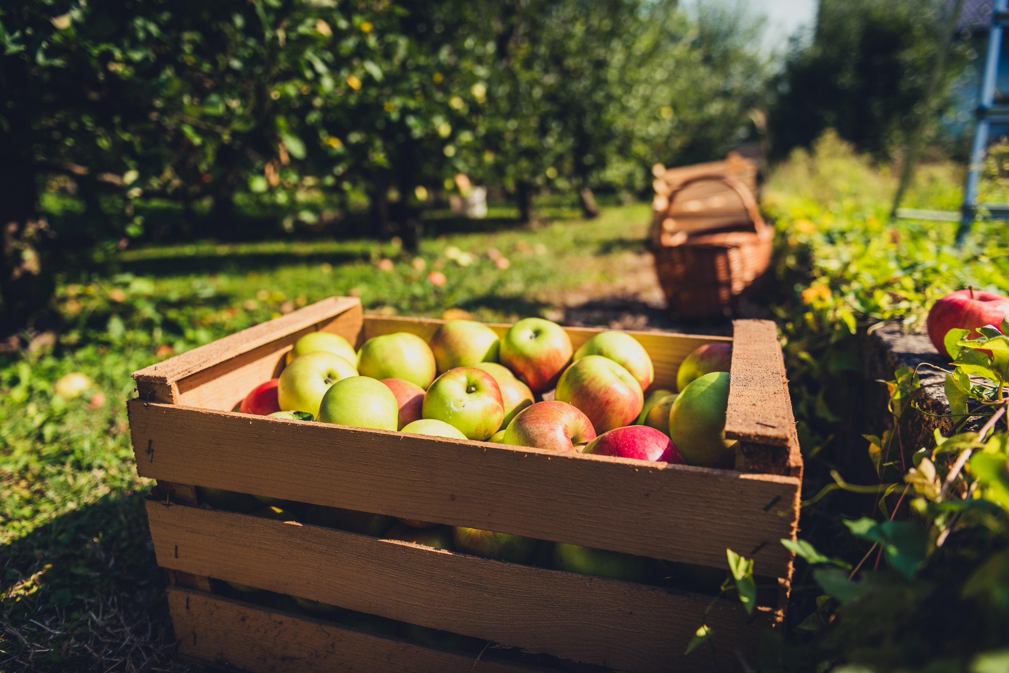
ZIP Code Search
Gavin Cyr

Slide 9
ZIP Code Search Functionality
Purpose & Features
How it Works:
Allows users to get a single ZIP code's zone, subzone, and temperature range of that zone
Search by ZIP code
Search ZIP code and look for plants in that zone
The user enters a ZIP code
The user data is pulled from the page and checked for criteria
A URL is built based on the entered information
Data is requested
Data is retrieved and processed into a table format
Table is sent to the webpage for display

Slide 10
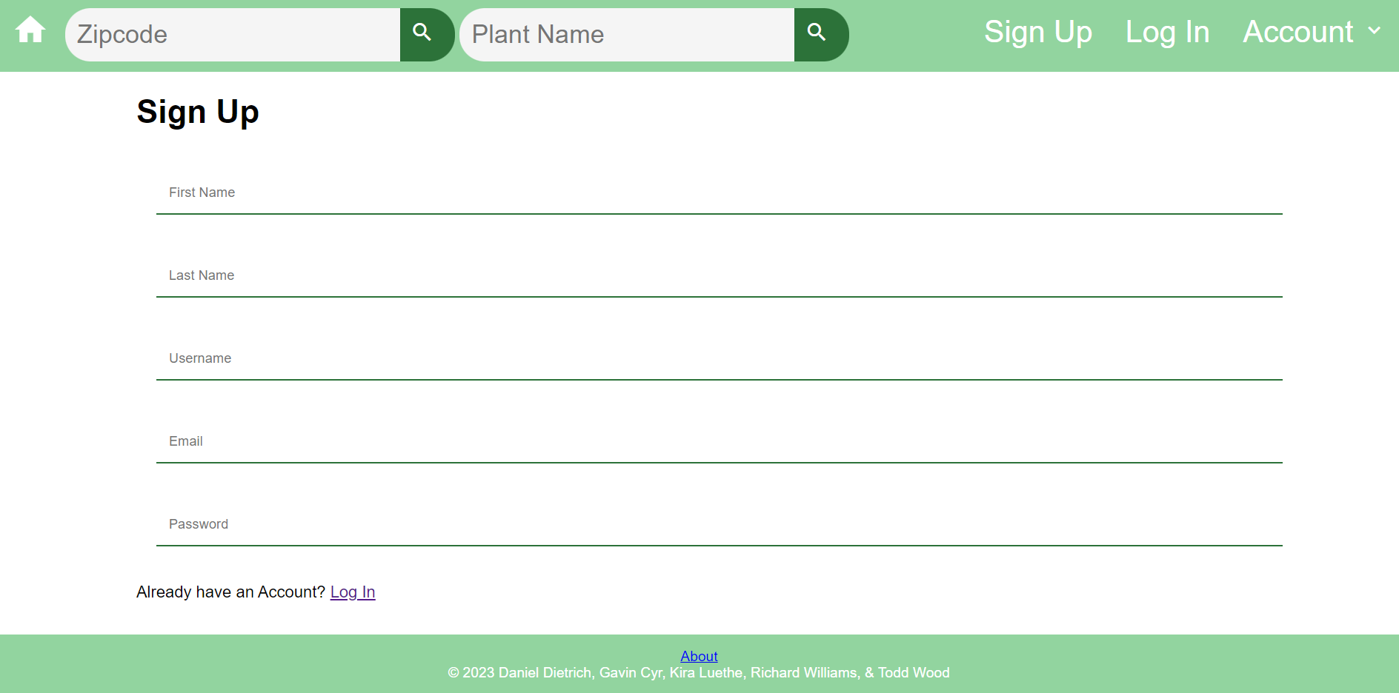



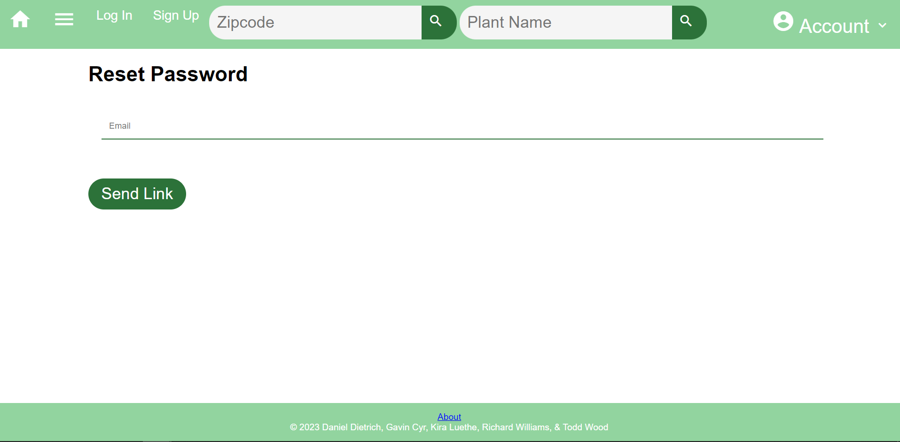
Account Creation & Password Resets
Daniel Dietrich

Slide 11
Account Creation Outline:
Features:
How It Works:
Secure Data Handling.
Checking against database to enforce unique usernames.
Feedback messages based on Account Creation results.
Automatic sign in upon successful Account Creation.
User enters all required data on the Sign Up Page.
Username is checked against existing users to enforce unique usernames.
Password is hashed and a new user is created using the provided information.
User is automatically signed in using the secure User Authentication feature.

Slide 12
Password Resets Outline:
Features:
How It Works:
Confirmation of email against database users.
Embedded Encoded User ID in Password Reset URL.
Timely Password Reset emails using PHP Mailer.
Feedback messages based on Password Reset Results.
User enters their email on the Reset Password page.
If the provided email has an account, a reset email is sent to the email address.
User opens the provided link and enters a new password.
The password is updated for the User's account and the User is directed to the Sign In page.

Slide 13


Thank you

